Slide 1
Software Architecture & Design Lecture 01: WHAT IS SOFTWARE ARCHITECTURE?
Sarmistha Sarna Gomasta

Slide 2
Lesson Objective
To familiar with the term “Software Architecture”

Slide 3
Lesson Outcomes
After this lesson, students will understand
what the term software architecture means

Slide 4
What Are Your Thoughts?
Apply your experience and background to define the following:
Enterprise architecture
System architecture
Software architecture

Slide 5
Enterprise Architectures
Enterprise architecture is a term commonly used in business today, but what does it really mean?
Enterprise architecture is a means for describing business structures and the processes that connect them.
It describes the flow of information and activities between various groups within the enterprise that accomplish some overall business activity.
Enterprise architectures may or may not be supported by computer systems.
Software and its design are not typically addressed explicitly in an enterprise architecture.

Slide 6
System Architecture
A system architecture is a means for describing the elements and interactions of a complete system including its hardware and software elements.
System architecture is concerned with the elements of the system and their contribution toward the system’s goal but not with their substructure.

Slide 7
Where Does Software Architecture Fit?
Enterprise architecture and system architecture provide an environment in which software lives.
Both provide requirements and constraints to which software architecture must adhere.
Elements of both are likely to contain software architecture.

Slide 8
Typical Software Architecture – 1
A software architecture is often depicted using an ad hoc box-and-line drawing of the system that is intended to solve the problems articulated by the specification.
Boxes show elements or “parts” of the system.
Lines show relationships among the parts.

Slide 9
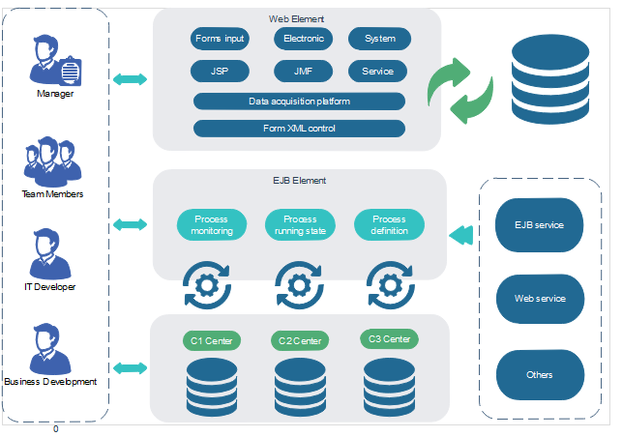
Typical Software Architecture – 2

Slide 10
What Can We Tell from This Picture?
The system consists of many elements?
The elements interact with each other over various networks?
Some of the elements represent layers and their relationships to one another?
The applications involved and the elements they comprise?
The system has multiple tiers?
The data, control, and communication mechanisms that are used?

Slide 11
What Does This Picture Omit? – 1
What is the nature of the elements?
What is the significance of their separation?
Do they exist at runtime?
Do they run at separate times?
Are they processes, programs, or hardware?
Are they objects, tasks, functions, or processes?
Are they distributed programs or systems?
What are the responsibilities of the elements?
What do they do?
What functions do they provide in the context of the system?

Slide 12
What Does This Picture Omit? – 2
What is the significance of the connections between the elements?
Do the elements
communicate with each other?
control each other?
send data to each other?
use each other?
invoke each other?
synchronize with each other?
What is the significance of how the elements are positioned on the diagram?
For example, does Shop Kwik use, call, control, and/or contain Personalization Services, Reporting Services, and Order Management Services?

Slide 13
What is a Software Architecture?
“The software architecture of a system is the set of structures needed to reason about the system, which comprise software elements, relations among them, and properties of both.”
Bass, L.; Clements, P. & Kazman, R. Software Architecture in Practice, Third Edition.Boston, MA: Addison-Wesley, 2012.

